Slide 1
Turtle Party
putting it all together
Notes:
Congratulations on progressing to Day 5! Awesome work! Today we’re going to integrate all the new skills you’ve been learning. Plus, at the end of the video I’ll share with you an exclusive opportunity to continuing your learning moving forward.

Slide 2
Look how far you’ve come!
Notes:
Today I really want to celebrate your python programming journey throughout the challenge so far by looking at where we’ve been.
Display to the screen with print
Store data in variables
Take advantage of expertly written code with libraries
Automate repetitive tasks with for loops
Scale our programs & improve their design with functions
So what do we get to do today?

Slide 3


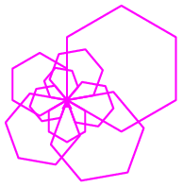
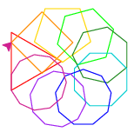
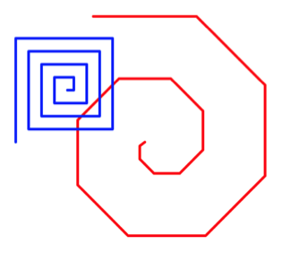
Challenge Overview
Day 1: Getting started
Day 2: Variables & Turtle
Day 3: Loops
Day 4: Writing Functions
Day 5: Putting it all together!
Hello, World!
Notes:
So what do we get to do today?
In the context of the challenge, today we get to celebrate your accomplishments by putting everything you’ve learned together!

Slide 4
Putting it all together: Turtle Party!
Go to trinket.io/turtle & load the code from Day 4
We’ll improve DRYness by implementing a general-purpose polygon function as well as a spiral function
See worksheet for details & video solutions: bit.ly/beginning-python-challenge-day5
What’s next? Are you ready to take your python skills to the next level?
Notes:
At this stage in your journey, you’re ready to try implementing functions by integrating all you’ve learned so far.

Slide 5
What’s next?
Keep the community conversation going: facebook.com/groups/joy.of.coding
Stay up to date: fb.me/joyofcoding4all
Follow along: bit.ly/joy-of-coding-youtube
Notes:
Join the Joy of Coding Facebook Group to get
Daily feedback from the community on your learning
Follow the Joy of Coding Facebook Page to get the latest updates on
new learning materials & course offerings
Learn about new videos as they are released by subscribing to the Joy of Coding YouTube Channel
Have you enjoyed your experience in this 5 day challenge? Are you ready to invest in yourself, invest in your python mastery to get to the next level?
Because if you are, I hope you will consider enrolling in the Joy of Coding Python Project. If you’ve learned this much in 5 days, think how much more you could learn in 6 weeks!

Slide 6
Notes:
This is Emily from Joy of Coding -- wishing you Happy coding & take care

